Slide 1
Open OnDemand: Open Source General Purpose HPC Portal
Basil Mohamed Gohar
Web and Interface Applications Manager
This work is supported by the National Science Foundation of the United States under the award NSF SI2-SSE-1534949.

Slide 2
Open OnDemand Overview
About Open OnDemand
Using Apps
How does it work?
Installation Procedure
Site Integration
Extending the Platform

Slide 3
About Open OnDemand
Open source software project
Installable for an HPC cluster (or clusters)
Standalone system, Lab, Department, University or National Resources
More than just an “out of the box” solution
OnDemand is a platform that can be extended through additional and custom apps

Slide 4
OnDemand Features
Single point of entry for HPC Center’s services
User needs three things
URL: ondemand.xxx.edu
Username
Password
Zero install (Completely browser based)
Single sign-on
Firewall friendly (Keep traffic on https port)

Slide 5
Open OnDemand Overview
About Open OnDemand
Using Apps
How does it work?
Installation Procedure
Site Integration
Extending the Platform

Slide 6
Open OnDemand App Features
App | Features
Dashboard | Browse and Launch Apps.
File Browser | Browse directories. Upload/Download. Move and Rename.
File Editor | Multiple themes. Key bindings. Syntax highlighting.
Terminal | SSH session to login node.
My Jobs | Create and submit jobs to cluster.
Active Jobs | Display job queue.

Slide 7
Open OnDemand App Features
Interactive Demo #1

Slide 8
Open OnDemand Overview
About Open OnDemand
Using Apps
How does it work?
Installation Procedure
Site Integration
Extending the Platform

Slide 9
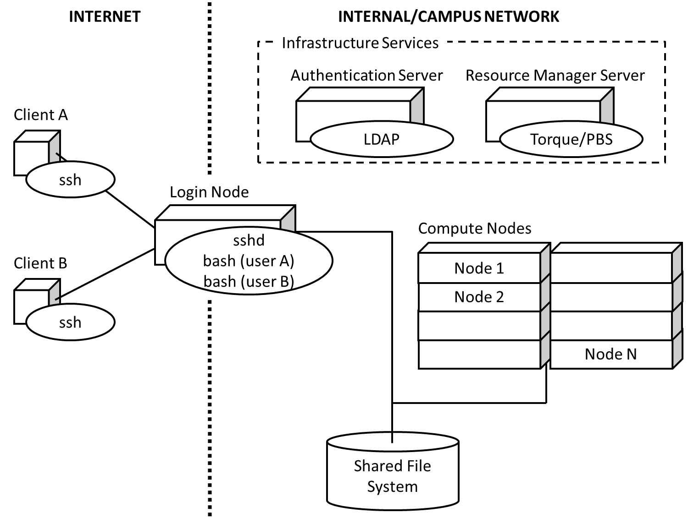
How does it work?
Our View of the World
Clients connect to login node through SSH
Interact with batch system and shared file system through the “bash” user process

Slide 10
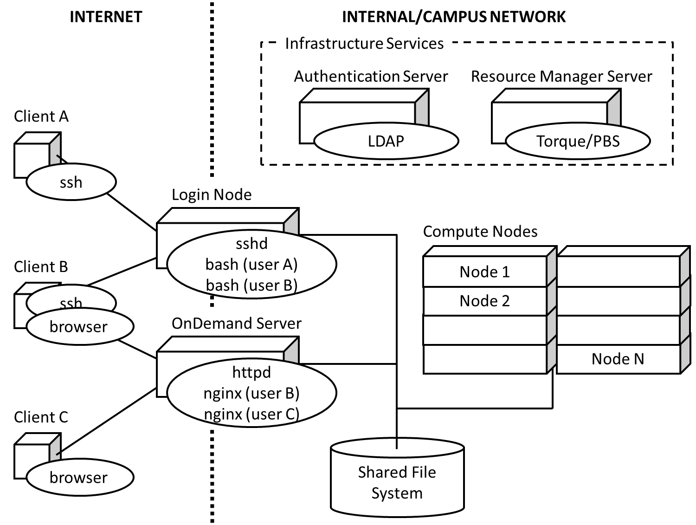
How does it work?
We introduced an “OnDemand” server
Similar to a traditional login node
Same authentication
Talks to the same resource manager
Mounts the same shared file system

Slide 11
How does it work?
Now clients may also connect to OnDemand server through browser
The “httpd” proxy starts up a per-user nginx (PUN) process for each user
The PUN launches apps as children processes

Slide 12
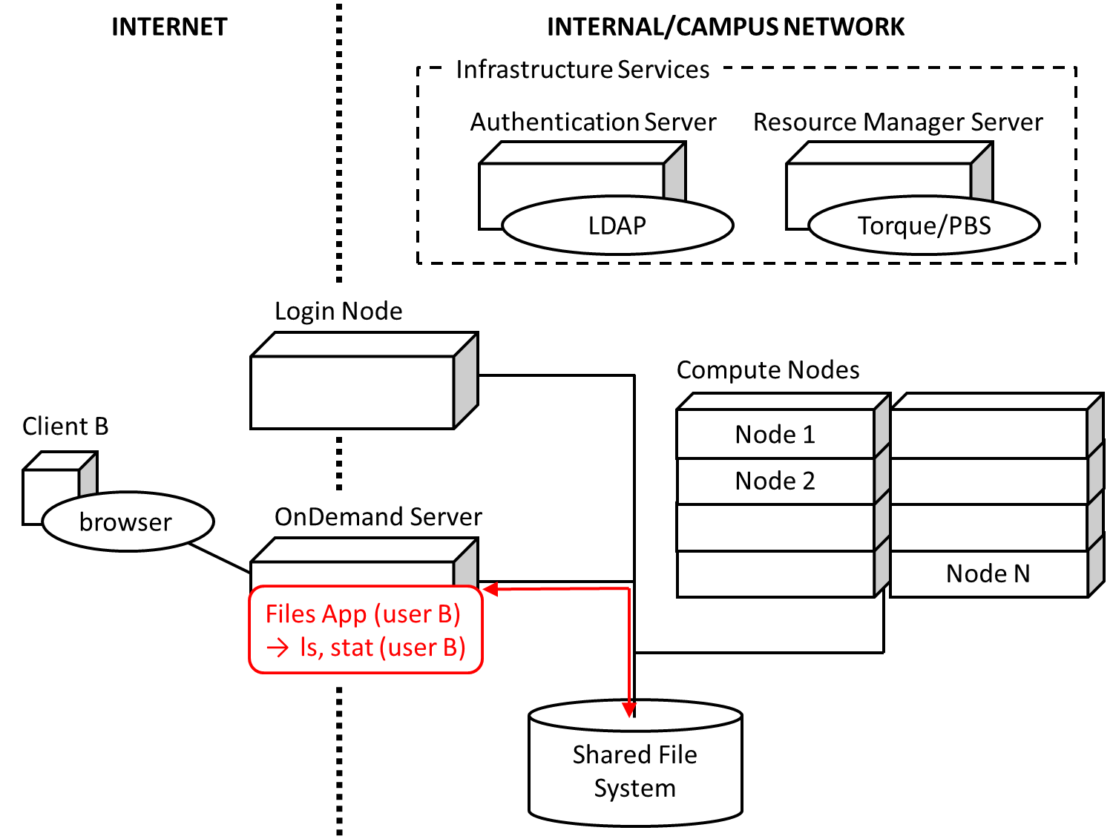
How does it work?
The “Files App” launches as the user under the PUN
Interacts with the shared file system through the Node.js “fs” core library
File permissions are maintained as all processes run as user

Slide 13
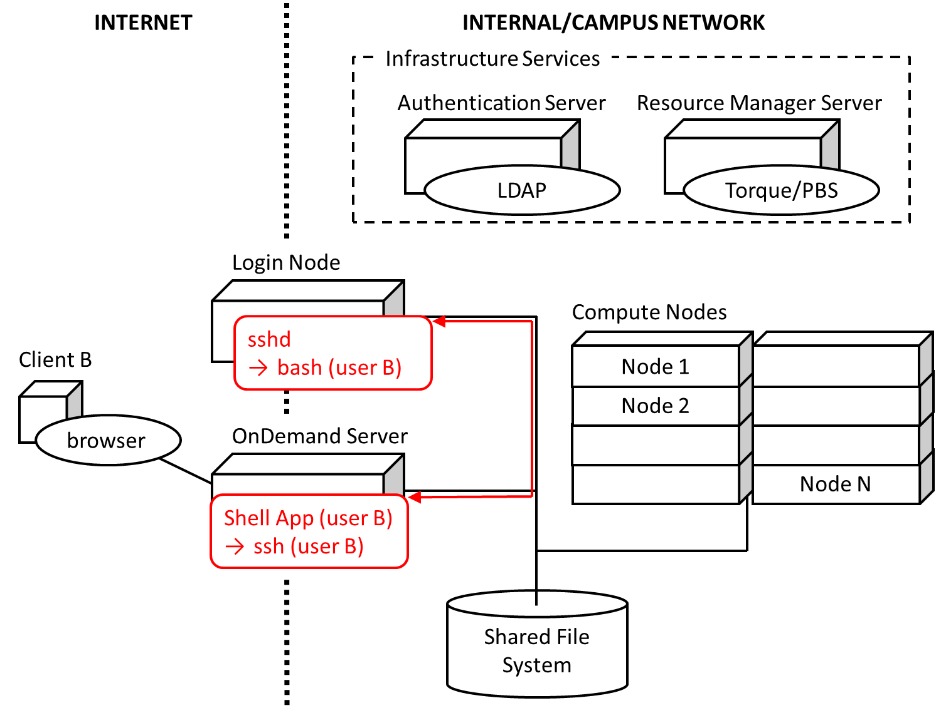
How does it work?
The “Shell App” launches as the user under the PUN
Within the shell app an “ssh” process is started connecting to the login node
The browser behaves as the terminal for the “ssh” process

Slide 14
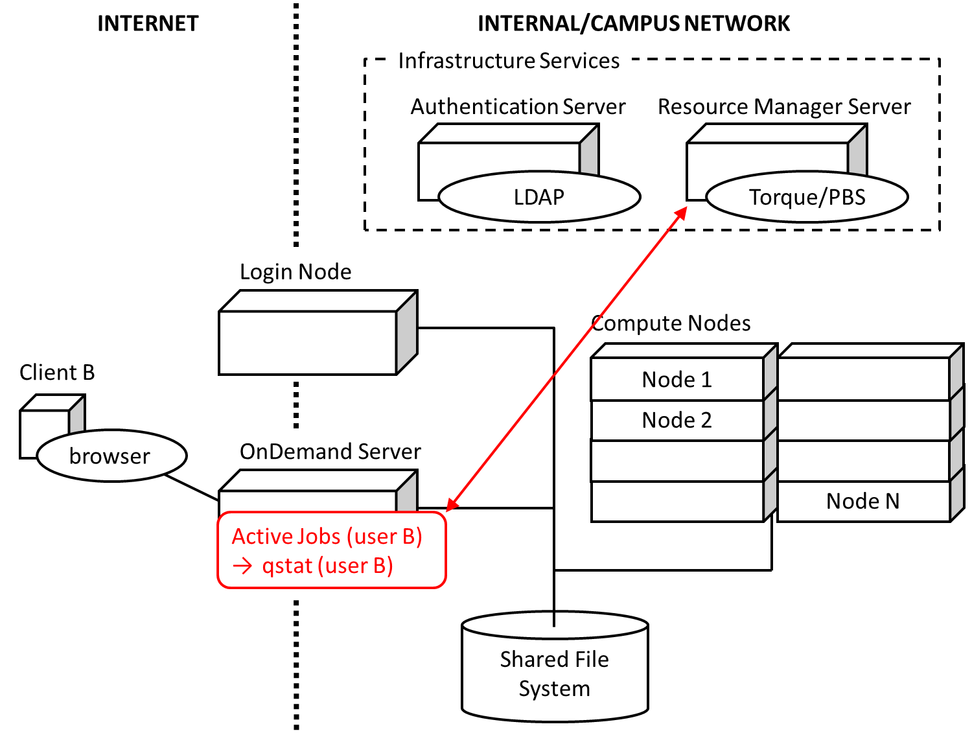
How does it work?
The “Active Jobs App” launches as the user under the PUN
Interacts with a Torque batch server
Equivalent to a “qstat” command called by the user

Slide 15
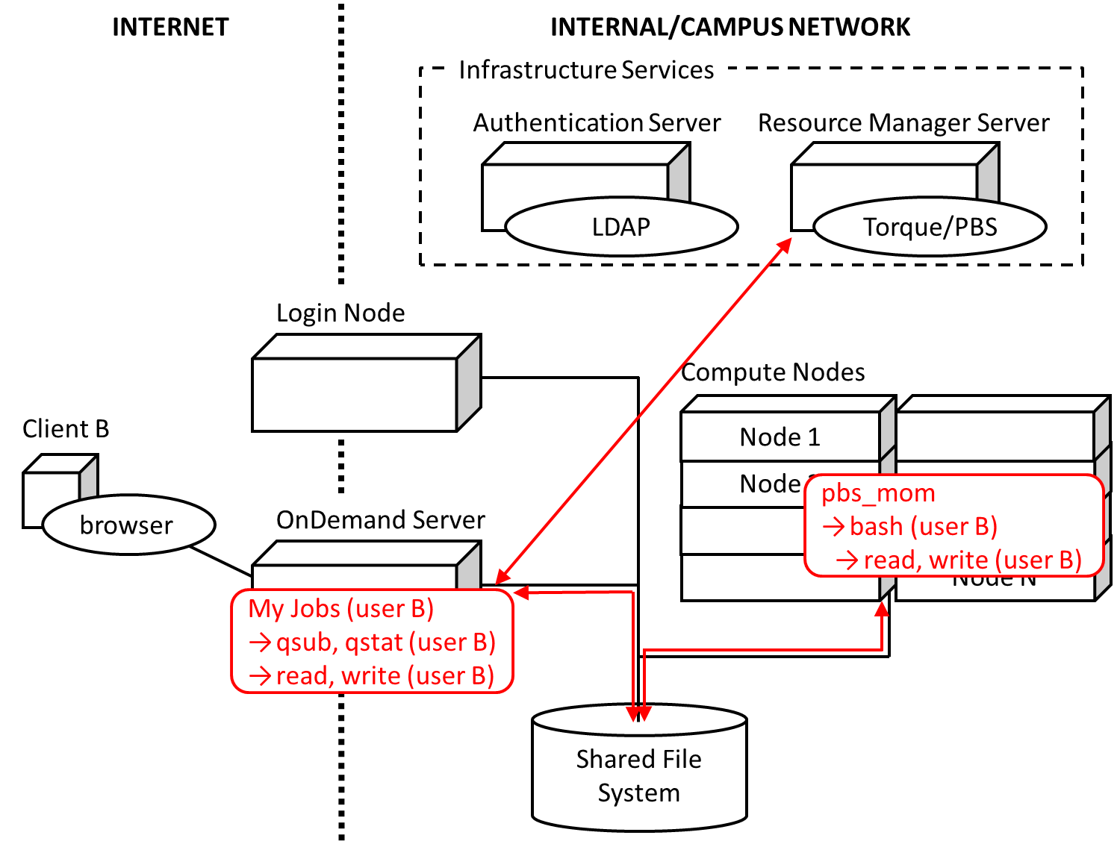
How does it work?
The “My Jobs App” launches as the user under the PUN
Submits jobs to Torque batch server
Writes input files and reads output files generated by batch jobs through shared file system

Slide 16
Open OnDemand Overview
About Open OnDemand
Using Apps
How does it work?
Installation Procedure
Site Integration
Extending the Platform

Slide 17
Installation Procedure
https://osc.github.io/Open-OnDemand/installation
Installation steps limited to OnDemand server
Install system dependencies
Apache, Ruby, NodeJS, Passenger, git (we use Software Collections)
Client libraries for authentication, resource manager, and shared file system access (like any login node)
Install Open OnDemand infrastructure from GitHub
Sets up web server to run apps
Install Open OnDemand apps from GitHub
Dashboard, Shell, Files, Editor, Active Jobs, My Jobs

Slide 18
Open OnDemand Overview
About Open OnDemand
Using Apps
How does it work?
Installation Procedure
Site Integration
Extending the Platform

Slide 19
Site Integration
Authentication setup
Connect to existing user directory (LDAP)
Federated authentication (CILogon)
OpenID Connect (CILogon, Keycloak)
Shibboleth
Batch setup
PBS/TORQUE
SLURM and LSF sites needed, we want to work with you

Slide 20
Open OnDemand Overview
About Open OnDemand
Using Apps
How does it work?
Installation Procedure
Site Integration
Extending the Platform

Slide 21
Extending the Platform
Vision: not just to provide these 6 apps, but to create a platform so any HPC user can build an app
All apps in Open OnDemand are Phusion Passenger apps
Using Passenger app server, Open OnDemand lets a developer drop a new app’s files into a directory and access it via a URL without requiring a manual server configuration or restart
NOTE: certain app changes may require a user-initiated app restart
Ruby, Node.js, Python-based apps are supported
Any user can write an app and use it without any help from the sys admin
Sys admin can deploy any app so that everyone can access it through the dashboard

Slide 22
Extending the Platform: Creating an App
Drop an app in $HOME
$HOME/ondemand/dev/APP
Install app specific dependencies (if any) in app subdirectory
Access app via URL
https://ondemand.xxx.edu/pun/dev/APP

Slide 23
Extending the Platform: Publishing an App
Add dashboard configuration manifest.yml file
$HOME/ondemand/dev/APP/manifest.yml
Copy app to production location
/var/www/ood/apps/sys/APP
Access dashboard (may require reload)

Slide 24
Getting Open OnDemand Installed at your Center
If your already run EL and PBS/TORQUE, you can download and install Open OnDemand now and try for yourself
If not, then we can try to work with you to get Open OnDemand extended to support your setup
Tell us how we can help!

Slide 25
Next Webinar/Staying in Touch
Our webinars are planned roughly quarterly
Let us know what you’d like to learn about next
Visit our website
https://osc.github.io/Open-OnDemand/
Join our mailing list
https://lists.osu.edu/mailman/listinfo/ood-users
Get Open OnDemand!
https://github.com/OSC/Open-OnDemand

Slide 26
Thank you! Any questions?
Basil Mohamed Gohar
Web and Interface Applications Manager
Ohio Supercomputer Center
bgohar@osc.edu
https://osc.github.io/Open-OnDemand/
go.osu.edu/ood

